Slide 1

Capital Budgeting in the Chemical Industry
      Guest Lecture
      ChE 473K, Process Design and Operations
      Prof. Poehl, Spring 2018
      Gerald G. McGlamery, Jr., Ph.D., P.E.
      Senior Advisor, Transformational Technology
      Global Chemical Research
      ExxonMobil Chemical Company
      Baytown, Texas

Slide 2
Agenda
Review of Time Value of Money
Review of Measures of Return on Investment
Basic Concepts of Risk
Stochastic Modeling
Cash Flow Bases

Slide 3
Review of Time Value of Money
Time Value of Money
Cost of Capital
Inflation

Slide 4
Time Value of Money
The value of money decreases with time because of
inflation
uncertainty about the future, i.e. risk
the desire for liquidity

Slide 5
Sources of Capital
Debt
Equity
  Common Stock
  Preferred Stock
Retained Earnings

Slide 6
Cost of Capital
Cost of debt
  Generally the lowest-cost source of capital because of the tax benefit.
  Must be paid, however, even if the venture loses money.
  Increases the risk of insolvency losses; risk premium therefore increases.
Cost of equity
  Can be valued as a function of the stock dividend, the dividend growth rate, and the stock market value.
  Can also be valued as a function of the risk-free return, the premium for equities over the risk free rate, and the correlation of the stock’s return with the market’s return (beta).
  Companies finance capital with equity to reduce the risk of failure.
Cost of retained earnings
  Treated as the equivalent of common stock.
  Investors have an expectation that the retained earnings will yield the same return as the stock.

Slide 7
Inflation
Inflation is an increase in the general level of prices.
In general, the U.S. Urban Consumer Price Index (CPI) is the accepted standard for measuring inflation.
For individual goods and services, projecting future values is not the same as adjusting for inflation.
For example, $1000 will purchase more computing power in 2018, but it will purchase fewer goods and services in general than in 2017.

Slide 8
Inflation (continued)
Project future values for an individual good or service in constant dollars, accounting for fundamental changes in supply and demand (including inputs).
Then, adjust for inflation to reflect the reduced buying power of money for all goods and services.
Some products might warrant no value adjustment.
Value Adjustment
Actual Value or Price
Inflation
Present Year
Next Year

Slide 9
Review of Measures of Return on Investment
Net Present Value
Internal Rate of Return
Inflating Cash Flows
Investment Hurdle Rates

Slide 10
Net Present Value
The net present value (NPV) is the sum of all cash flows after discounting each cash flow for the discount rate, i.
Nominal Cash Flows
Net Present Value
Discounted Cash Flows

Slide 11
Internal Rate of Return
The internal rate of return (IRR) is the discount rate that results in an NPV of zero.
Multiplying both sides by (1 + i)^{z}, the IRR equation can be recast as

Slide 12
Flaws of Internal Rate of Return
On the basis of IRR, Project A is preferred.
On the basis of NPV @ 5 %, Project B is preferred.
On the basis of NPV @ 8 %, Project A is preferred.
IRR does not detect the sensitivity of a project to discount rate and therefore risk.
The riskier the project, the more valuable the early cash flows.
IRR does not account for differences in project life or investment magnitude.
Project A Nominal Cash Flows
IRR = 15.1 %
NPV @ 5 % = $1361
NPV @ 8 % = $855
Project B Nominal Cash Flows
IRR = 12.6 %
NPV @ 5 % = $1437
NPV @ 8 % = $769

Slide 13
Flaws of Internal Rate of Return (continued)
Recall the second form of the IRR equation:
The IRR equation is a polynomial in (1 + i).
A polynomial will have as many real roots as it has sign changes.
Nominal Cash Flows

Slide 14
Inflating Cash Flows
Inflate revenue and costs with time rather than using constant currency values.
Reasoning:
  Because depreciation is not inflated, inflation cannot be added simply to constant-currency IRR.
  Cost of capital has inflation built into risk-free rate.

Slide 15
Investment Hurdle Rates
Companies set investment hurdle rates over the cost of capital because
  deterministic methods of analysis do not account for uncertainty
  resources other than cash are limited

Slide 16
Basic Concepts of Risk
Definition of Risk
Comparisons of Risk

Slide 17
Definition of Risk
Risk is characterized by the
  probability of an event.
  magnitude of an event.
For our purposes, we characterize risk as the probability distribution of outcomes of an event.

Slide 18
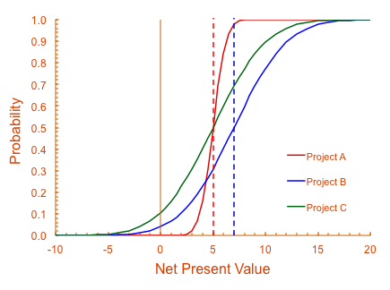
Comparisons of Risk
Project A is less risky than Projects B and C because of its small standard deviation.
Projects B and C have the potential for greater loss and greater gain than project A.
Projects B and C have equal risk, but Project B has a higher NPV at all probabilities.
Projects B and C both have significant, though not large, probabilities of losing money.
Remember, this is a cumulative distribution, so the probability shown is the probability for an NPV less than or equal to a certain value.
Would you choose project A or project C?

Slide 19
Stochastic Modeling
Basis of Stochastic Modeling
Choosing Variables for Modeling
Sources of Data
Cognitive Biases
Time Correlation of a Variable
Correlating Two or More Variables
Bounded Sums

Slide 20
Basis of Stochastic Modeling
f(x_{i})
Stochastic modeling relies on repeated sampling from input variables described by probability distribution functions to generate a probability distribution function for one or more output variables.
When the sampling is random, the analysis is called Monte Carlo analysis.
The resulting distribution is frequently normal. Why?

Slide 21
Choosing Variables for Modeling
Sensitivity analysis
  Input variables are systematically varied an equal amount above and below the base case to see which input variables yield the greatest changes in the output variables.
  The more sensitive the model is to a variable, the more effort should go into modeling that variable.
Input variable range is important
  If variable range is based on simple percentage of base value, output range will reflect only sensitivity of model
  If variable range is based on statistical distribution, output range will also reflect uncertainty in input variable.
Use the fewest number of variables that will capture 80–90 % of the output variation.

Slide 22
Tornado Plots
The tornado plot is effective for ranking the effects of various inputs on an output variable.
  Sensitivity of model to variable
  Magnitude of uncertainty in variable
Use the tornado plot also to diagnose model errors.
  Bars of zero magnitude
  Bar signs that are reversed

Slide 23
Common Sense Tests
In the chemical industry, economic models typically will be most sensitive to:
  Product price / sales volume
  Major raw material prices
  Investment costs

Slide 24
Sources of Data
The information you have is not the information you want.
The information you want is not the information you need.
The information you need is not the information you can obtain.
The information you can obtain costs more than you want to pay.
Most people overestimate the amount of information that is available to them.
Peter Bernstein
Against the Gods: The Remarkable Story of Risk
In God we trust. All others must bring their data.

Slide 25
Sources of Data (continued)
The Internet
Consulting Firms
Experts, Gurus, Gray-beards, etc.

Slide 26
Example Consulting Firms
IHS Chemical
ICIS
Nexant ChemSystems
Platts (McGraw-Hill)
Solomon Associates
Phillip Townsend Associates (PTAI)
Argus DeWitt
Tecnon OrbiChem
Chemical Data Inc. (CDI)

Slide 27
Experts, Gurus, Gray-Beards, etc.
Data on variability are rarely available in published sources, though they can be estimated from historical data.
Engineering judgment is a valid source of estimates of variability.
Be aware, however, that engineering judgment is subject to motivational and cognitive biases.

Slide 28
Cognitive Biases
Anchoring and adjustment
  People frequently anchor to an initial estimate and adjust for uncertainty when assessing probability.
Availability
  Information that is recent, dramatic, certified, or imaginable can increase a person’s assessment of probability.
Representativeness
  Current evidence can be mistaken for long-term trends.
Implicit conditioning
  People tend to make unstated assumptions when assessing probability.

Slide 29

An Example of Conditioning

Slide 30
Coping with Cognitive Bias
Motivate the expert by describing the stochastic modeling process and the use of the results.
Decompose the model to eliminate unstated assumptions.
Clearly state definitions.
  What is the price of gasoline?
  What is the price of unleaded regular motor gasoline, delivered to New York harbor?
Communicate using probabilities. Try to develop values for 10 %, 50 %, and 90 % cases as a minimum.
Clearly state the scenarios that yield the 10/50/90 % cases.
Verify the expert is comfortable with the result.

Slide 31
Time Correlation of a Variable
Example: model sales volume growth of 2 %/year
Deterministic model
Each year is independent
Each year is dependent on the prior year
Each year is correlated with time

Slide 32
Correlating Two or More Variables — Indexing
Lacking a better correlation, some variables can be indexed to other variables:
Examples of variables that can be indexed:
    Hydrogen ➔ natural gas
    Oxygen ➔ industrial electricity
    Nitrogen ➔ industrial electricity
    Steam ➔ industrial primary energy
    Freight ➔ diesel fuel

Slide 33
Correlating Two or More Variables - Regression
Linear regression estimates the coefficients describing a straight line:
y = ax + b
The linear regression model is actually
y = ax + b + N(0,σ)
where σ is the error about the regression line.
The error is given in most regression statistics as the mean square error (MSE). The square root of the MSE is σ.
The same concept applies for non-linear regressions.

Slide 34
Bounded Sums
Bounded sums arise frequently in chemical engineering models, e.g. the sum of the selectivities must equal 1.
Varying a bounded sum randomly can violate the bound if each element is not dependent on the other.
One solution is to choose three cases of sums that would be equivalent to 10/50/90 % cases on a continuous distribution function.
The three cases can be assigned probabilities of 25/50/25 % and simulated as a discrete distribution function.
In a spreadsheet, put all three cases in an array and use the INDEX, HLOOKUP, or VLOOKUP functions to select the correct case.

Slide 35
Cash Flow Bases
Marginal Cash Flows
Valuation of Chemicals
Modeling Prices and the Experience Curve
Integrated Value Chains
Supply Chain Costs
International Considerations

Slide 36
Marginal Cash Flows
Profits are maximized when marginal revenue equals marginal cost.
Cash flows for new investment should be based on highest cost and lowest price.
If I cannot expand and I get a higher margin sale, I would always forgo a lower margin sale.
It follows that each investment in incremental capacity becomes harder and harder to justify.
Marginal Revenue
Profit Maximized
Marginal Revenue and Costs
Marginal Cost
Sales Volume

Slide 37
Valuation Bases
Market price
  Best option if available
  Remember to use marginal value
Substitute or value price
  Equivalent functionality or value to another product
  Normalized to mass, volume, area, length, etc.
Next best disposition
  Commonly found in refineries
  Remember debit for replacement material
Cost of disposal

Slide 38
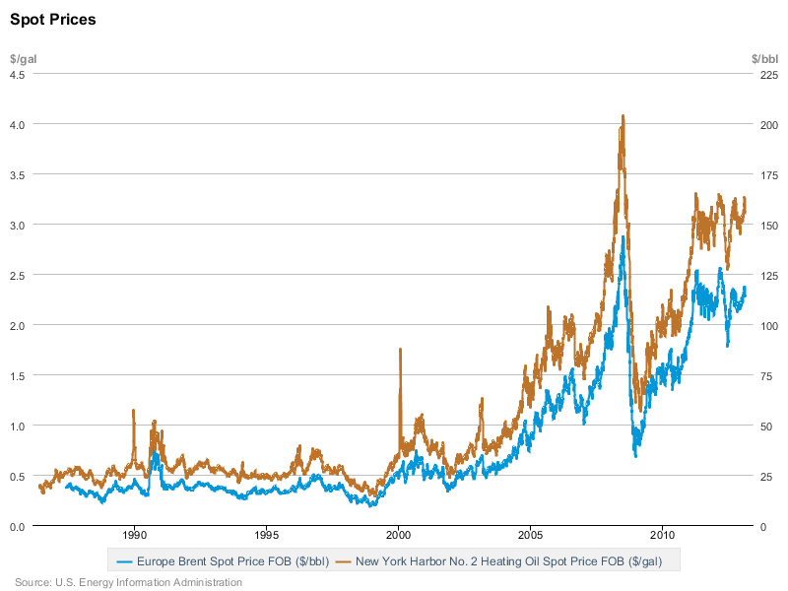
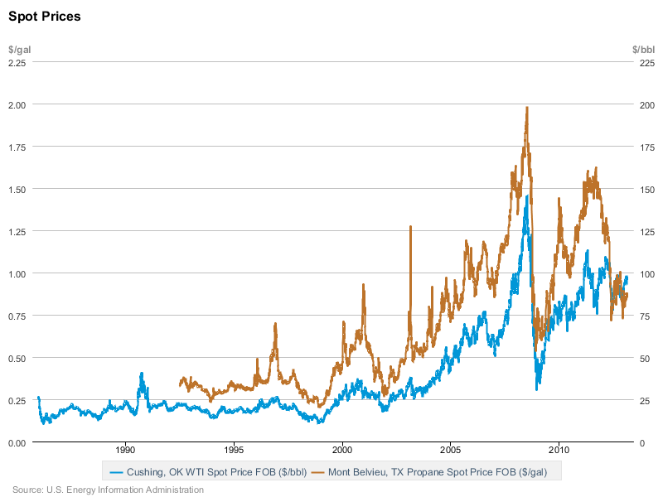
Correlation Between Product and Input Prices
No. 2 Heating Oil vs Brent Crude
Generally a high correlation between product prices and raw materials in CPI.
Most petrochemicals highly correlated with either crude oil or natural gas.
Other energy-intensive industries (e.g. metals, transportation) correlated with energy prices.
Propane vs WTI Crude

Slide 39
Price Models
Many models based on simple gross margin over raw materials.
  Constant margin in currency per unit mass (e.g. USD/T).
  Constant margin percentage of net raw materials.
Other model types are possible:
  Smoothing
  Correlative (regression)
  Theoretical / explanatory (supply/demand models)
Don’t confuse prices today with long-term trends.
  Transition from present prices to trend might be necessary.
  New capacity usually depresses prices below trend in early years.
  Add variability to near-term price trend, if not all years of project.

Slide 40
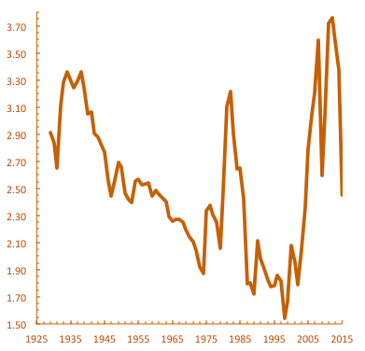
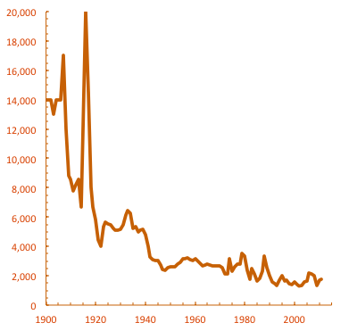
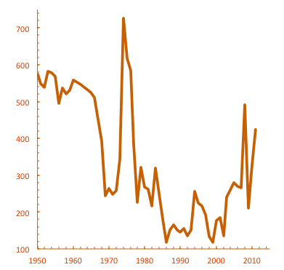
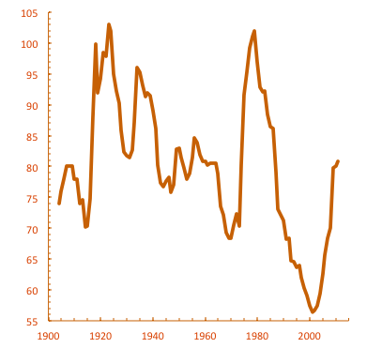
Examples of Historical Price Trends
Motor Gasoline (average price), 2015USD/gal
Aluminum, 1998USD/T
Source: U.S. Department of Energy
Source: U.S. Geological Survey
Ammonia, 1998USD/T
Lime, 1998USD/T
Source: U.S. Geological Survey
Source: U.S. Geological Survey

Slide 41
Pressures on Price
Downward trend of constant-currency prices with time is known as an experience curve.
Downward price pressures result from:
  Competition
  Substitution
  Innovations in end-use applications
Producers always under pressure to keep up.
  Learning curve
  Economies of scale
  Innovations in processes
Deviations from trend result from:
  Changes in input (raw material, labor, capital) prices.
  Changes in industry capacity utilization (supply versus demand).

Slide 42
One Formulation of the Experience Curve
Historical Prices and Costs
Regression
Typical value-added decline for petrochemicals is 20 – 40 % per doubling of cumulative production.
Raw materials have their own experience curves.
Regional variations typically explained by exchange rates, transportation, trade barriers.
Projected Prices and Costs

Slide 43
Experience Curve Implications for Capital Budgeting
Price forecasts in constant currency should assume a decline with time.
Possible forms:
  Percentage price decline per year
  Percentage price decline with cumulative industry production
  Percentage margin decline per year
  Percentage margin decline with cumulative industry production
  Value-added experience curve
Experience curve effects should apply to both product prices and input prices.

Slide 44

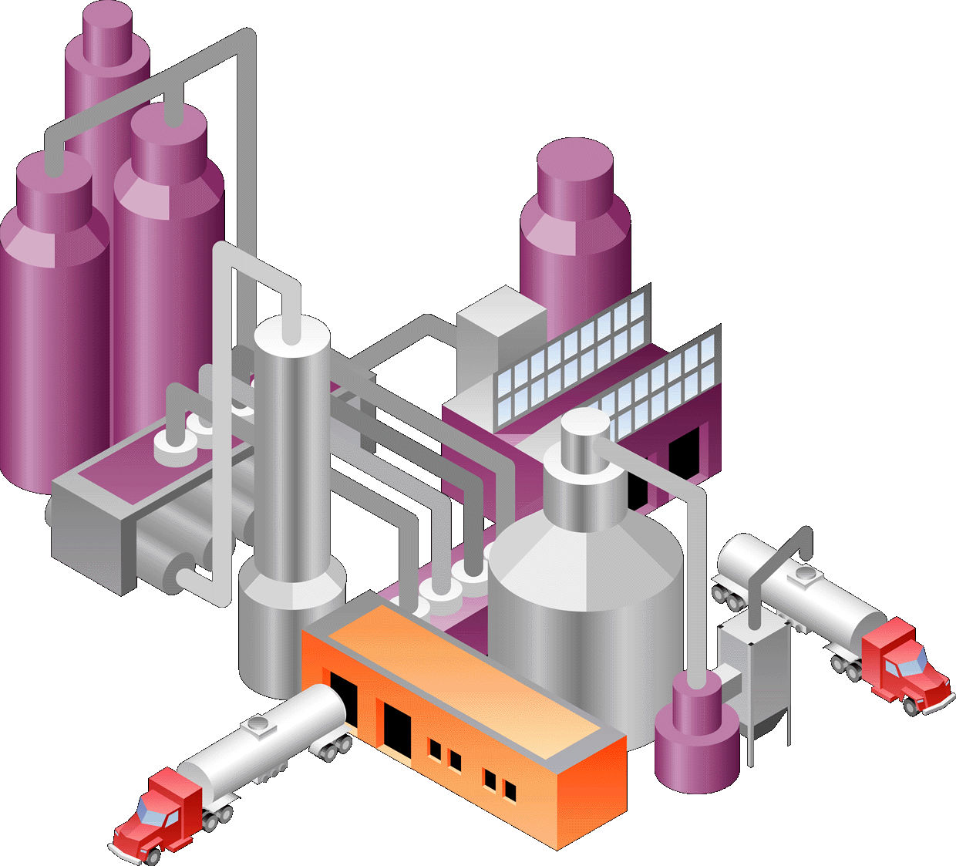
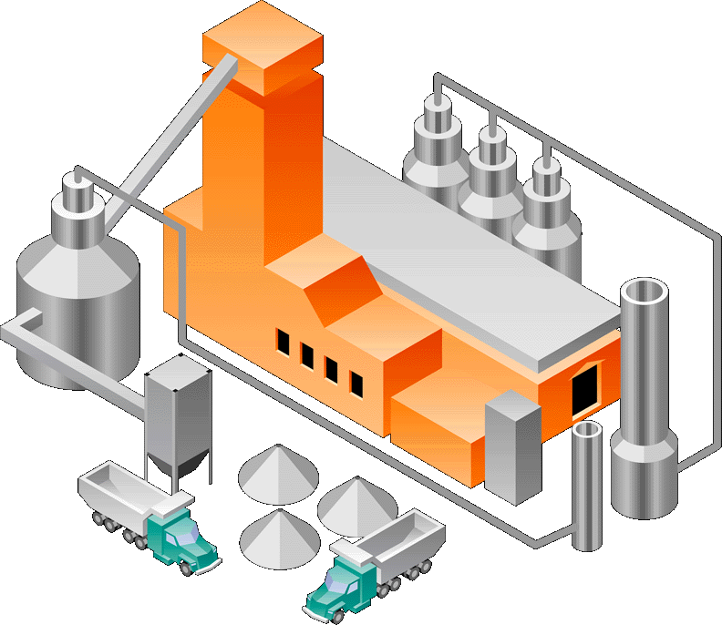
Integrated Value Chains (the transfer price problem)
Product B is valued at market in best case.
Frequently, B is not sold in commerce, or only a fraction of total production can be sold in commerce.
If value of B is too high, then no profit left to justify expansion of Unit 2; if too low, then no profit left to justify expansion of Unit 1.
Frequently, expansion of Units 1 and 2 not justified simultaneously.
Must pick arbitrary price marker that allows profitable return for expansion of both Units 1 and 2.
A
1
B
2
C

Slide 45
Integrated Value Chains (economic scope)
An economy of scope occurs when a firm can produce B and C cheaper together than can separate companies.
If NPV of unit 1 is negative, but NPV of unit 2 and sum of both is positive, many firms frequently invest.
Investment is only justified, however, if economy of scope is possible.
If economy of scope is not possible, then firm might align with partner with lower cost of capital or existing supplier, since market might be oversupplied.
A
1
B
2
C

Slide 46
Supply Chain Costs
Operating Costs
  Freight costs (inbound and outbound)
  Freight mode changes
  Storage rental
Working Capital
  Plant and forward inventories
  Accounts payable/receivable

Slide 47
International Considerations
Currency
Tax rules
  Rates
  Depreciation
  Investment allowances and credits
  Repatriation of funds and transfer pricing
Ownership
  Profit sharing
  Cost of capital
Trade costs
  Tariffs, duties, drawbacks
  Non-financial barriers
  Frictional costs, e.g. traders, freight forwarders

Slide 48
Spreadsheet Economic Models
Flexibility is the key to a good model.
  Avoid hard-coding data.
  Do unit, molecular weight, and density conversions in the spreadsheet.
Use the workbook concept to organize the model in modules that are easy to update. Separate inputs, outputs, and calculations on separate pages.
Take advantage of built-in functions.
  Note that Excel’s NPV function discounts the first-period cash flow.
  Use the MIN or MAX functions to bound calculations.
Be careful with linking spreadsheets.
  Values have a habit of changing when you least expect it.
Document everything!

Slide 49
Wisdom on Modeling
All models are wrong, but some are useful
  George E. P. Box
Far better an approximate answer to the right question, which is often vague, than an exact answer to the wrong question, which can always be made precise.
  John Tukey
Not everything that can be counted counts, and not everything that counts can be counted.
  Albert Einstein

